Slide 1
Broward Participatory Action Research We Are Supported Care Coordination IDS
Sue Gallagher
Chief Innovation Officer
Children’s Services Council of Broward County

Slide 2
Broward Data Collaborative 2017
Broward County Demographics
Broward’s Data Collaborative (BDC) integrates state and local data to contribute to the well-being of Broward’s children, families and communities.

Slide 3
Florida IDS Partners Call
Broward County Demographics
Purpose: Regularly convene local and state partners to enhance integrated data sharing across Florida.
Build Network Relationships
Maximize existing structures (ie., legal, technology, research, etc)
Accelerate building IDSs
Advocate for state/local infrastructure development

Slide 4
Why Community Participatory Action Research (CPAR) ?
Broward County Demographics
Act of Research is Healing
Builds capacity of youth and families to use data, make decisions, lead, and advocate
Expands professionals’ empathy, understanding, and tacit knowledge of people receiving services
Possible solutions and strategies are expanded and enriched through relationships and the rigor of diverse perspectives
Face difficult truths together
Inspirational & Joyful

Slide 5
Participatory Structures
Broward County Demographics
Build trusting & efficacious relationships with system professionals with youth & parents
Co-research, co-imagine, co-construct solutions together, and share systemic capacity building
People are powerful, knowledgeable, compassionate and can become change agents who can partner and belong in the process to make systemic contributions

Slide 6
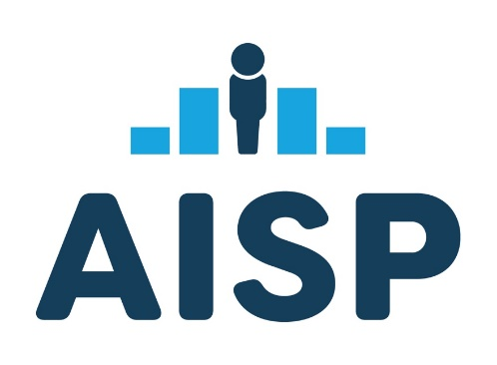
Broward’s History of CPAR Projects
2018/19 Federal Performance Pilot Partnership grant
(Feds $50,000 & CSC $17,000)
Parents
System Pros
Youth
2019/20, Florida Institute of Child Welfare grant
(FICW $50,000 & CSC $12,000)
2023/24, UPENN AISP
Equity in Practice Learning Community grant
($70,000)

Slide 7
Broward CPAR Innovation
Broward County Demographics
Context Experts (i.e., lived experience expertise)
Youth and Parents who experienced Baker Act
Content Experts (i.e., formal expertise)
System Professionals
(public agencies, funders, mental and behavioral health care providers, and Insurance Company)
Humanizing & Transformative Relationships that produced rich data, discussion and policy, system, and
narrative change

Slide 8
Key CPAR Learnings
Baker Act experience was traumatizing, including the feelings of:
criminalization due to Law Enforcement transporting youth to facilities
dehumanization caused by families knowing nothing about the Baker Act process and youth feeling helpless (no choices about what happens) and fear of non-compliance.
re-traumatization by the separation of families during the process, made worse due to the extremely limited visitation and communication between parents and their children.
Co-researchers provided input and feedback on a
family-centered consent form for the We Are Supported
integrated data system
Notes:
Sue
A key innovation to Public Science Project’s approach was to include System Professionals in the work as co-researchers – typically CPARs are done with youth and researchers or parents and researchers – we intuitively recognized that value of including system professionals who were also transformed through the projects.

Slide 9
We Are Supported Integrated Data System
Broward Data Collaborative
Technology Partners
Healthcare & Insurance Partners

Slide 10
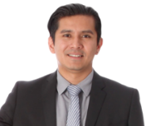
We Are Supported Care Coordination IDS 1.0
3. Organizations, for whom consent has been given, receive notification of admission
Alfredo and Melanie,
Parent / Caregivers
Christania, Hospital Staff
1. Baker Act facility obtains informed consent upon admission
Integrated Data System (IDS)
2. IDS links youth to organizations for whom consent has been given

Slide 11
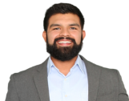
We are Supported IDS 2.0+
Anthony, Primary Care Physician
1. Care givers manage consent
Alfredo and Melanie,
Parent / Caregivers
Alisha, Social Worker, BCPS
Dennis, Case Manager, BBHC
Nicole, Probation Officer, DJJ
Integrated Data System (IDS)
James, Non-Profit Coordinator, CSC
2. Supportive services exchange information about the youth with the IDS
3. IDS links information to the youth
4. Care team members, for whom consent has been given, can view holistic information about the youth they support
Devon, Dependency Case Manager, ChildNet
Christania, Hospital Staff

Slide 12
One Design Possibility
BH Repository
Policy Makers
Policy

Slide 13
Florida BH Information Culture Continuous Learning Upstream Solutions Nourish Community Fabric
Community
FL BH Repository
Policy Makers
Local Hubs of Relationships, Insights, Healing, Innovation

