Slide 1
Crisis Center of Tampa Bay Baker Act Transport Overview

Slide 2
History
Baker Act transportation is provided by the Crisis Center’s TransCare Medical Transportation division.
TransCare began providing services in Hillsborough County in 1982 serving non-emergency psychiatric patients via local ordinance established through the Hillsborough County Transportation Exception Plan.
Began Basic Life Support (BLS) ambulance services in 1996.
Has retained the Hillsborough County contract since 1982.
Currently provide behavioral transportation services in Hillsborough and Pasco Counties (Pasco Schools).

Slide 3
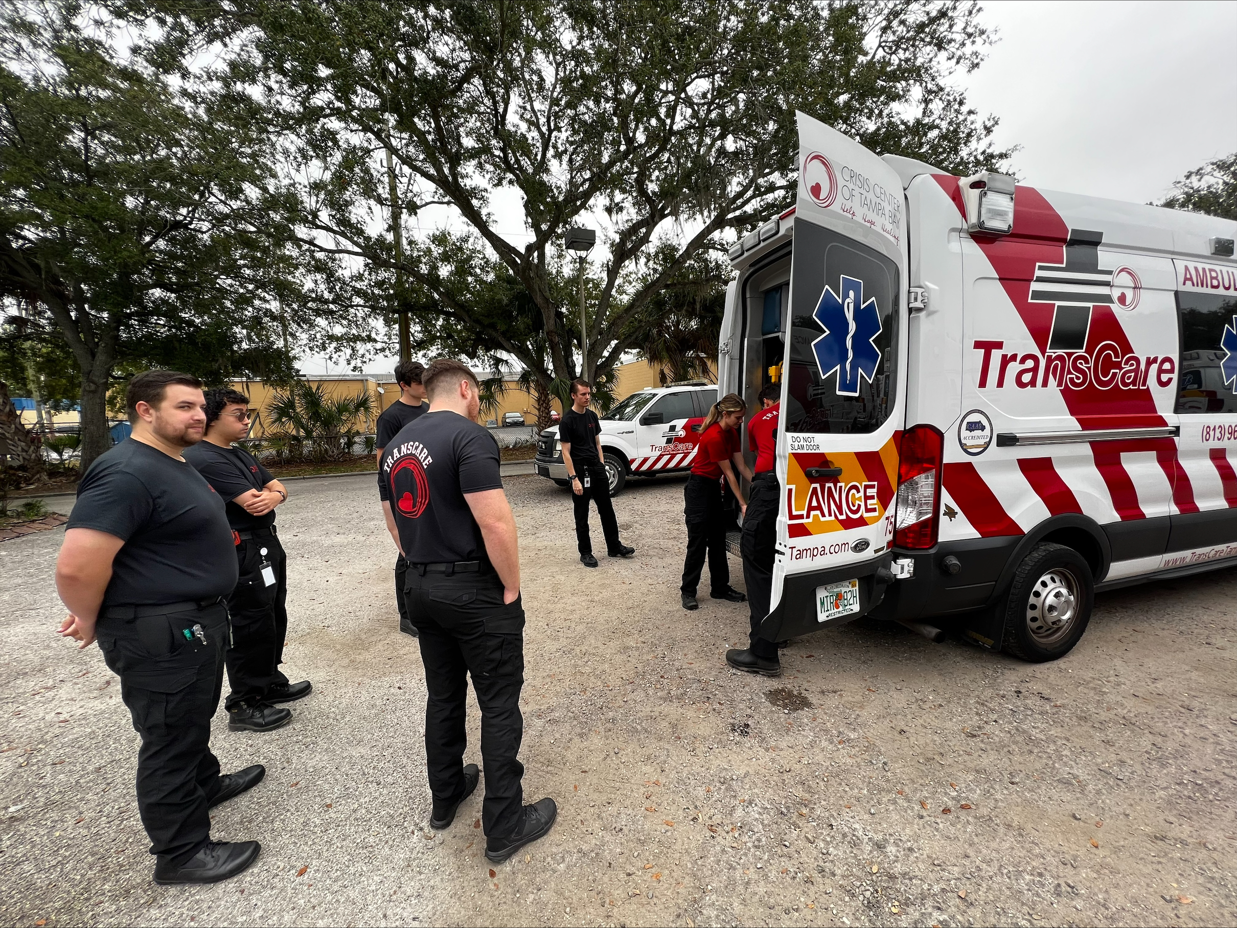
Training
All TransCare employees participate in “Core Training”
Trauma Informed Care
Mental Health First Aid 1 and 2
Psychological First Aid
Welle (De-escalation Training)
EVOC (Emergency Vehicle Operator’s Course)
Behavioral Health Attendants additionally receive the following:
36 Hours of Baker Act and Marchman Act specialty training
Safety and Sensitivity training
All clinical training is overseen by the agency’s Medical Director and administered in partnership with local and national educational institutions.

Slide 4
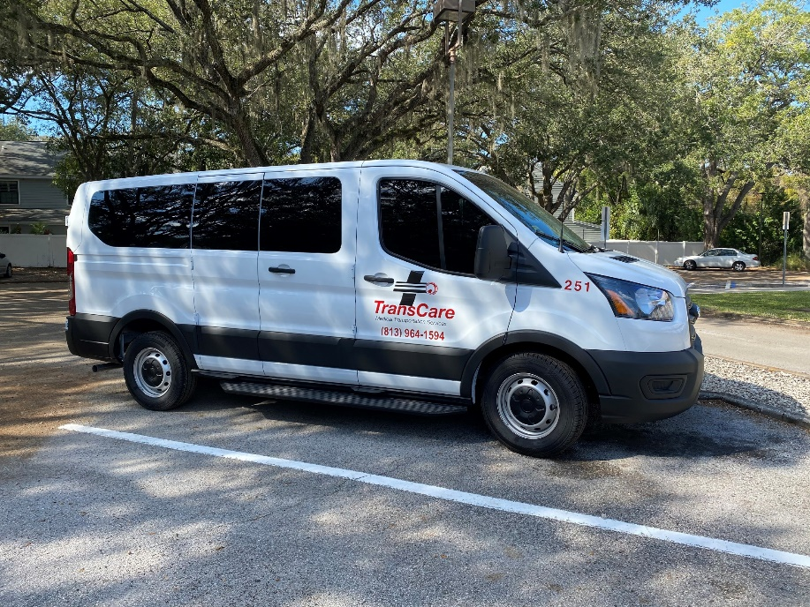
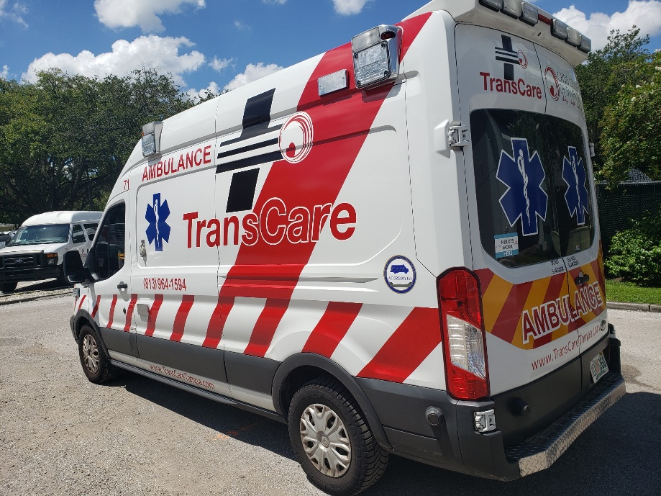
Transportation
Low profile transportation to maintain patient dignity, privacy, and decency
Patient safety prioritized
BHA Van
BLS Ambulance

Slide 5
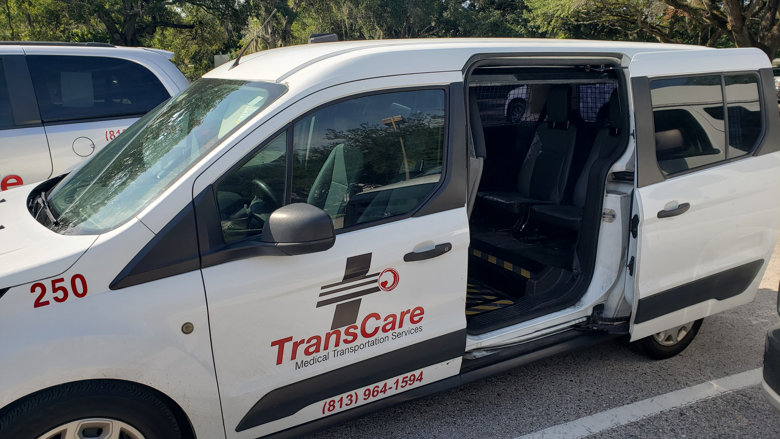
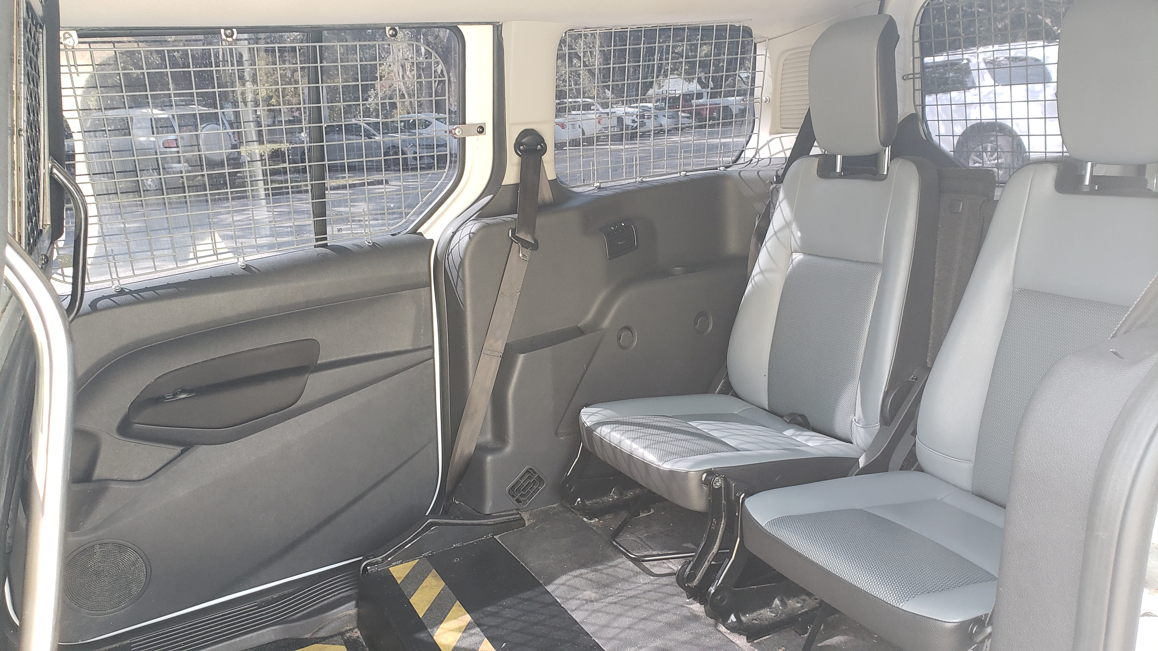
Inside Safety of Vans
All vans have protective measures to keep the driver separate from the patient in the rear of the vehicle.
All windows are covered and secured.
The doors to the patient compartment can only be opened from the outside.

Slide 6
Key Transportation Designators
For the patient to be transported by van:
Patient must be physically capable of being able to step into a van
Patient is not under the influence of any substance
Patient is non-combative and cooperative
Patient will be transported by ambulance if:
Needs medical clearance
Patient is physically unable to get in the van
Under the influence of any substance
Is combative or a flight risk

Slide 7
Process/Protocol
Law enforcement/clinicians determine if law enforcement transport is necessary.
If not, the 211 line or TransCare Dispatch is called.
TransCare will transport the person to a receiving facility or to a hospital if basic life support medical care or medical clearance is necessary.
TransCare does not transport patients who are seeking voluntary admission that are void of Baker Act or Marchman Act status.
The exception would be if the patient presents with a basic life support medical condition requiring transportation to a hospital.

Slide 8
Process/Protocol
Does the Patient have a choice of Facility?
Choices may be limited by bed availability, geographic location, funding, and the degree to which a person manifests dangerous behaviors.
Within these parameters, if a person requests to the mobile crisis response team or law enforcement a particular hospital or facility, the person may be transported directly to that facility.

Slide 9
Baker Act Receiving Facilities in Hillsborough County
Gracepoint Receiving Facility – Central Receiving Facility
Children's Crisis Stabilization Unit – juvenile only
St Joseph Hospital Behavioral Health Center – adult and juvenile
HCA Florida West Tampa Hospital – adult only
James A Haley Veterans Administration Medical Center – adult only
BayCare/Northside Mental Health – adult only

Slide 10
Arranging Transportation
There are 2 ways law enforcement/MRT/licensed clinician can request a unit for transportation.
Call 211
Call TransCare Dispatch
Both methods are available 24/7
Law Enforcement scene calls have the highest priority
Schools would be considered a scene call and be prioritized in the same manner
Dispatchers have been trained in Emergency Medical Dispatch and will ask several questions to determine if a van or ambulance is needed

Slide 11
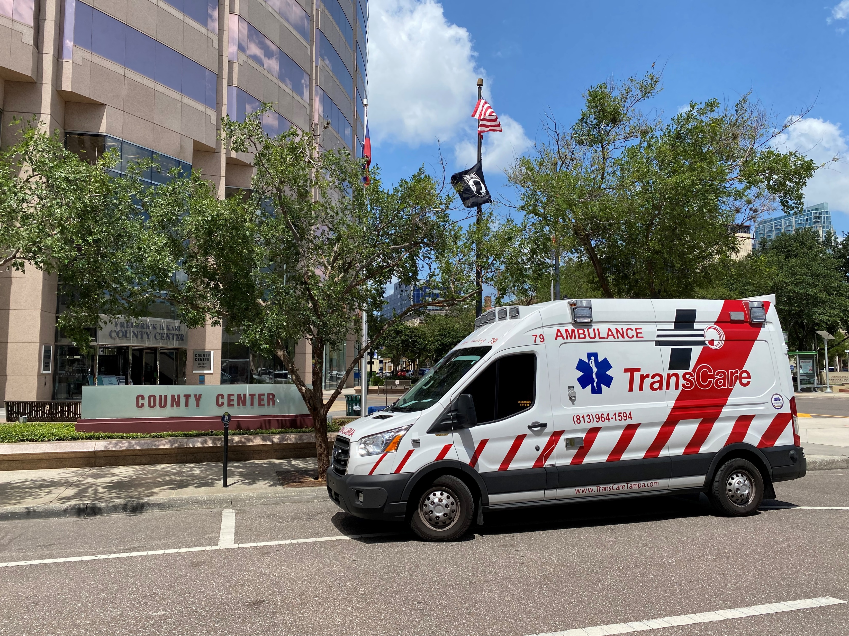
Transport Frequency
In fiscal year 2023, TransCare provided over 9,600 Behavioral Health Transports.
In December of 2023, TransCare averaged 22 Behavioral Health Transports per day.

Slide 12
Transport Costs
Behavioral Health Van Transport: $140
Per mile fee: $5
Transport fees covered through local government contracts

Slide 13
Questions?

